Slide 1
Future Plans & Feedback
James & Ray

Slide 2
What changes do YOU want to make at YOUR institution?
What MRE education project would you like to implement?
Did today’s discussion help with your project?
What tools/resources/partners do you need for your project?

Slide 3
Contact Info
Carlotta Berry
berry123@rose-hulman.edu
Greg Lewin
glewin@wpi.edu
Melissa Morris
MORRIM44@erau.edu
James Mynderse
jmynderse@ltu.edu

Slide 4
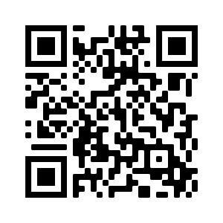
Please complete our survey
We will also send the link via email to registered participants

